Slide 1
Subroutines on the Raspberry Pi
by
Bruce Embry

Slide 2
Introduction to Subroutines
Subroutines on the Raspberry Pi are very similar to subroutines on the LC-3 simulator. However, they are much easier to create, to use, and to share.

Slide 3
Similarities with LC-3
The return address is stored in a register. This means that if you are going to call a subroutine from within another subroutine, you must save the value of the Link Register, (R14), before you do. Otherwise, you will lose the return address of the outer subroutine.
Parameters and return values are passed in registers.
You can save your subroutines to the same file as your main program.

Slide 4
Differences with LC-3
The Gnu Compiler Collection on the Raspberry Pi has a true linker. Therefore, you can:
  create subroutines that are in their own file.
  assemble them separately.
  link them to create the final executable.
  share assembled subroutines with your classmates to simplify creating your final projects.
GCC also supports external symbols, which are resolved by the linker.

Slide 5
Calling a Subroutine
The instruction for calling a subroutine in ARM6 is BL which means “Branch with Link.” It is exactly like a regular branch instruction, with the added feature that the current value of PC is stored to R14, the Link Register.
Additionally, since PC is a general purpose register, the link address can be stored manually where ever you like. Then the subroutine can be entered with a regular Branch instruction, or by simply loading PC with the correct address.

Slide 6
Testing Your Subroutine
Subroutines should not do any input or output (unless that is their purpose.) So to test it and debug it, you should write a test program that will get input from the user, call your subroutine and then provide output in some way.

Slide 7
Building a Subroutine Library
You may create a group of subroutines that perform related functions, such as the functions for a four-function calculator. If the functions are interdependent, you should probably combine them into a single assembly language file. Then all the labels will be local to that file, and the entire file can be linked to the main program in one step.

Slide 8
Sharing Subroutines
I encourage you to work together in teams to produce your final projects. This will be easier if you assign responsibilities for developing subroutines. One person can be primarily responsible for each subroutine, and can provide documentation to allow his teammates to use his subroutine without having to understand the details of how it works.

Slide 9
Documentation
When you share subroutines, you should provide documentation that is external to the source code and includes:
The global label by which the subroutine can be called.
The required parameters and the registers in which they will be stored
The return values and the registers in which they will be stored.
Any error checking and error-code values

Slide 10
Example: convert.s
Subroutine global label: convert
Purpose: converts an ascii string of digits into the decimal value.
Parameters:
R0 - address of the string of digits
R1 - number of digits to convert
Return value:
R0 - decimal value of the digits
Error check:
Verifies that all the characters are decimal digits; returns -1 if they are not

Slide 11
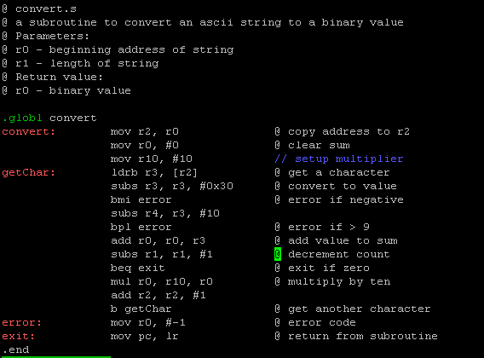
Source Code: convert.s

Slide 12
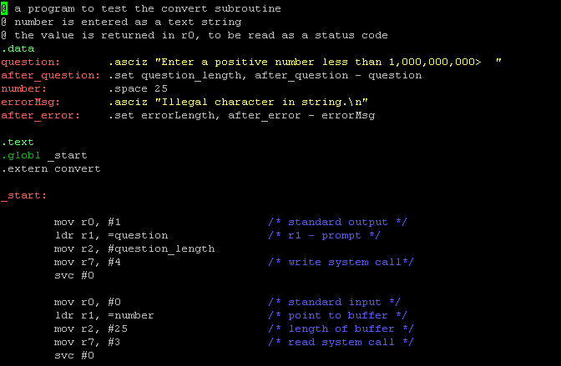
Source Code: test.s

Slide 13
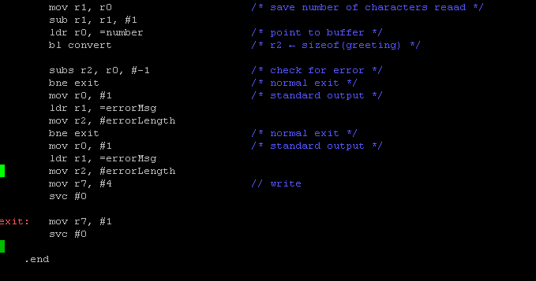
Source Code: test.s (cont.)

Slide 14
Summary
On the Raspberry Pi, it is very easy to write your programs as a series of subroutines, either incorporated into a single file, as individual subroutine files, or as subroutine libraries.

